Slide 1
Instrument Classification & Identification
By Tianxu An, Reynold Chan, Ahmed Rosanally, Tiffany Yau
🎸 🎹 🎺 🎻

Slide 2
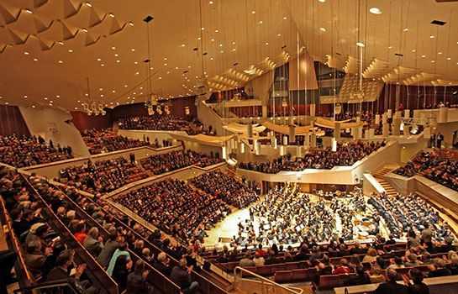

Slide 3
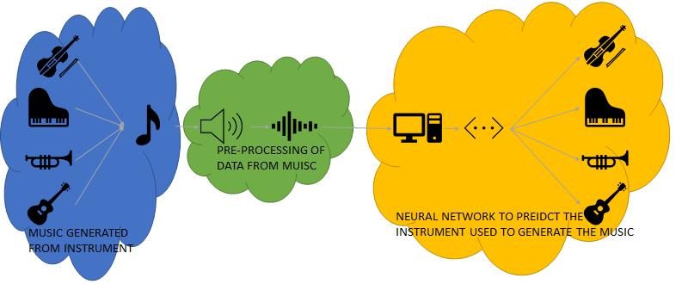
The Problem:
PREDICT

Slide 4
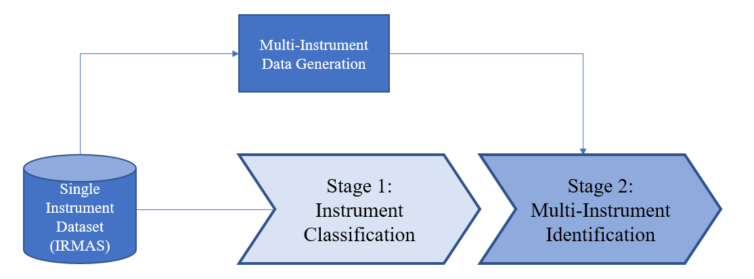
Frame and Scope:

Slide 5
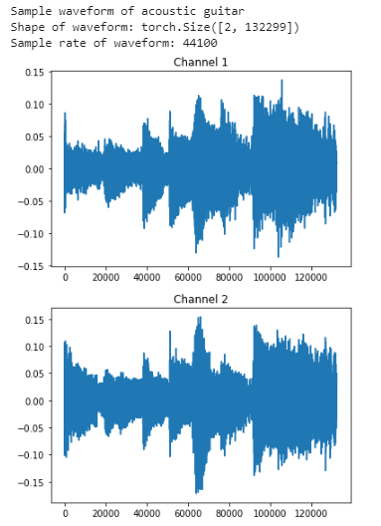
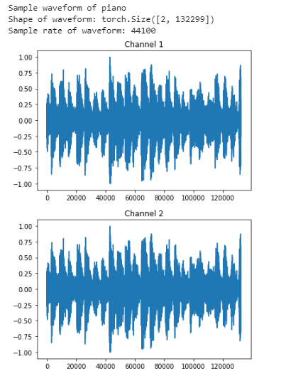
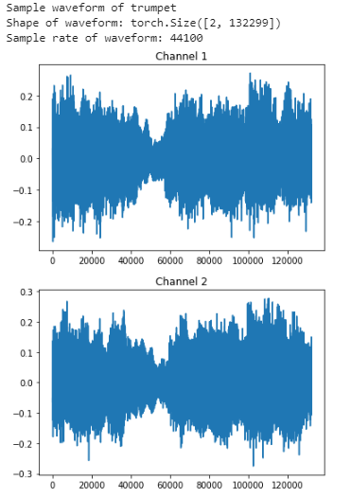
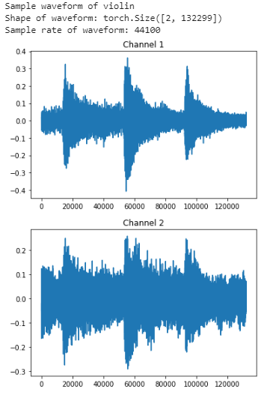
Selected Data
🎸
🎹
🎺
🎻

Slide 6
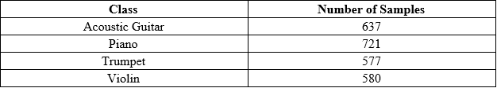
Unbalanced Classes

Slide 7

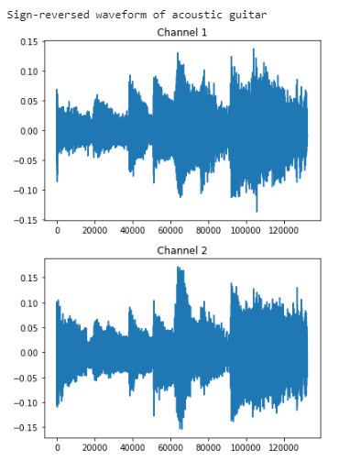
Data Balancing

Slide 8
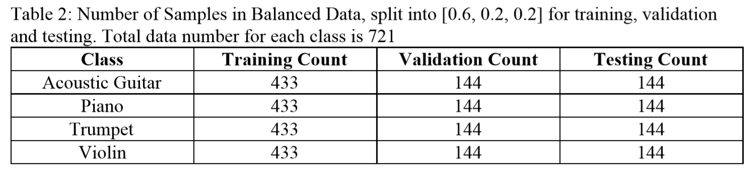
Balanced Classes

Slide 9
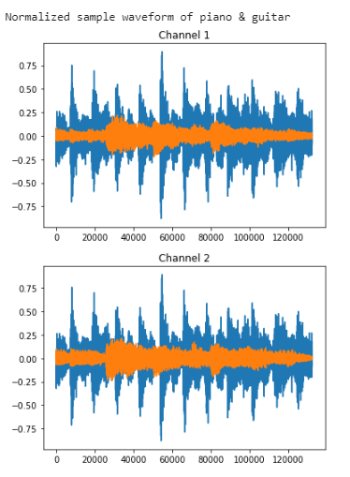
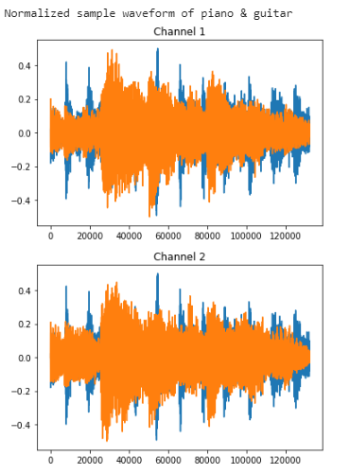
Data Normalization

Slide 10
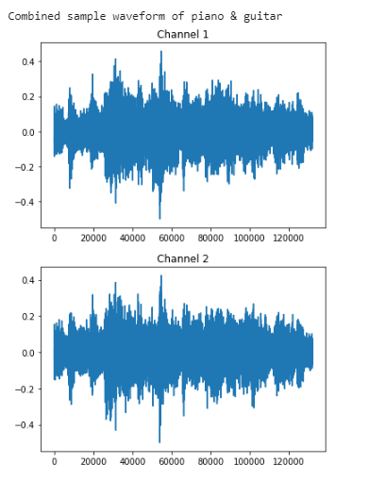
Generating New Data

Slide 11
Data Limitations
Limited music styles
Combined audios deviate from real duets
Normalized volume
Not the same music

Slide 12

Baseline Model

Slide 13
1D CNN Models
🎸
🎹
🎶
🎵
🎺
🎻

Slide 14
Stage 1: Instrument Classification
🎸 🎹 🎺 🎻
[0.1 0.2 0.6 0.1]
Model Output
[0 0 1 0]
Target
nn.CrossEntropyLoss()

Slide 15
Stage 1: Tuning the Model
High Impact Hyperparameters
Other Tested Hyperparameters
Dropout (30%)
Kernel, pooling sizes
Batch size
Only 1 FC layer, decreasing its size (>8000 → 254)
16
Batch normalization
↑ convolution layers, ↑ filters
LeakyReLU vs. ReLU
Learning rate
0.0003

Slide 16
Stage 2: Multi-Instrument Identification
🎸 🎹 🎺 🎻
[0.8 0.2 0.1 0.7]
Model Output
[1 0 0 1]
Target
nn.MultiLabelSoftMarginLoss()

Slide 17
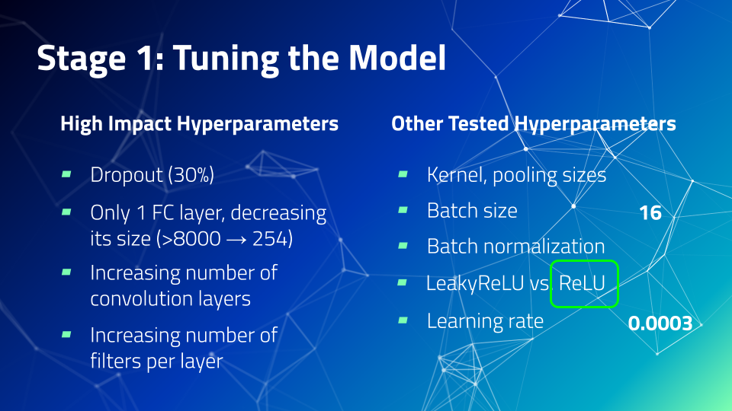
Stage 2: Tuning the Model

Slide 18
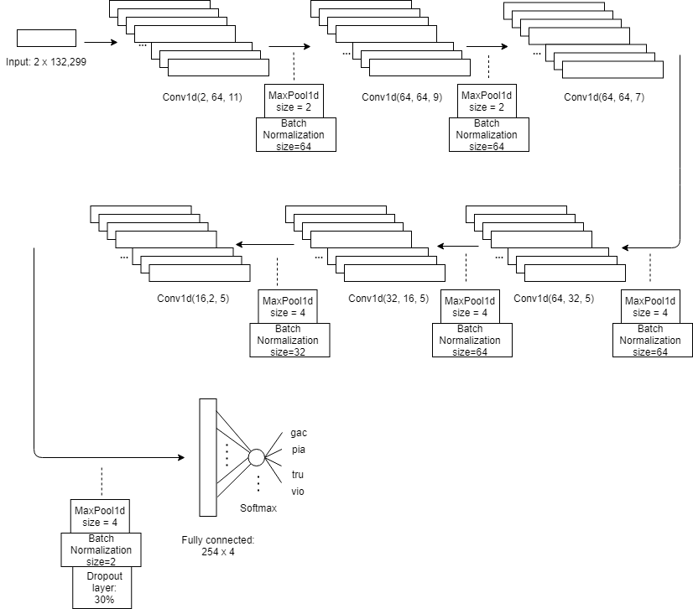
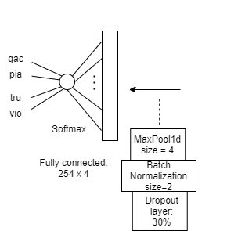
1D CNN Architecture

Slide 19
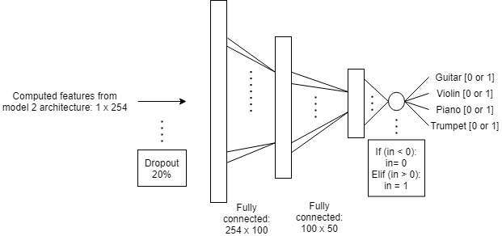
Stage 2: Transfer Learning Architecture

Slide 20
Stage 2: CNN vs. Transfer Learning
 | CNN | Transfer Learning
# Learnable Parameters | 81166 | 30754
Computation Time per Epoch (seconds) | 93 | 0.33
Overall Average Computation Time | ~30 mins | 3.3 sec

Slide 21
Summary of Results
 | Validation Accuracy | Test Accuracy
Stage 1: 1D CNN | 72.57% | 70.66%
Stage 1: Baseline Model Accuracy | 43.3% | 40.3%
Stage 2: 1D CNN | 69.05% | 69.74%
Stage 2: Transfer Learning | 68.21% | 64.16%
Stage 2: Baseline Model Accuracy | 38.7% | 36.7%

Slide 22
Stage 1 Test Results - 70.66% acc.
🎺 performs the best
🎹: often misclassified as 🎸
High accuracy for 🎸 but false positives and negatives split between 🎹 and 🎻
Potential reasons:
🎸 string plucking can resemble 🎹 or 🎻
 | Predicted Label
True Label |  | 🎸 | 🎹 | 🎺 | 🎻
 | 🎸 | 113 | 23 | 1 | 15
 | 🎹 | 57 | 81 | 7 | 3
 | 🎺 | 4 | 8 | 116 | 3
 | 🎻 | 25 | 11 | 12 | 97

Slide 23
Stage 2 (CNN) Test Results - 69.74% acc.
 | Predicted Labels
True Labels |  | 🎸🎹 | 🎸🎺 | 🎸🎻 | 🎹🎺 | 🎹🎻 | 🎺🎻 | Other
 | 🎸🎹 | 21 | 35 | 32 | 2 | 1 | 1 | 65
 | 🎸🎺 | 20 | 25 | 19 | 2 | 0 | 0 | 75
 | 🎸🎻 | 11 | 13 | 70 | 0 | 3 | 1 | 44
 | 🎹🎺 | 4 | 2 | 1 | 53 | 13 | 5 | 60
 | 🎹🎻 | 1 | 4 | 11 | 25 | 13 | 15 | 70
 | 🎺🎻 | 7 | 3 | 18 | 11 | 18 | 10 | 81
 | Other | 0 | 0 | 0 | 0 | 0 | 0 | 0

Slide 24
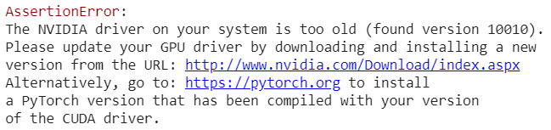
Key Takeaways & lessons learned
Problem was very complex
Poorly implemented with nn.BCEWithLogitsLoss() instead of nn.MultiLabelSoftMarginLoss()
Software library dependency - using torchaudio library package
 | Validation Accuracy | Test Accuracy
Stage 1: Baseline Model Accuracy | 43.3% | 40.3%
Stage 2: Baseline Model Accuracy | 38.7% | 36.7%

Slide 25
Thank you for listening
🎶
🎻
🎺
🎸
🎹
🎵

